Slide 1

Final Project Small Business Applications and Loan Amounts
QSO 560 – Descriptive Business Analytics
Created by Risha Alam

Slide 2

Visualizations

Slide 3
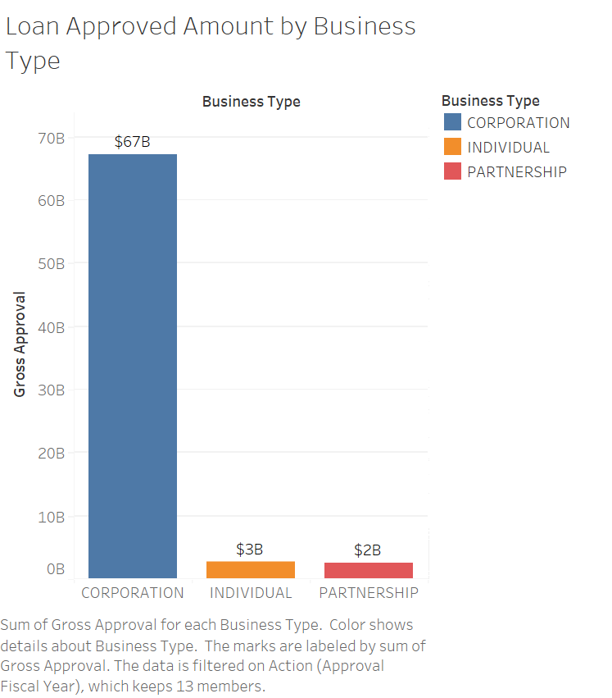
Corporations are the business type that appears to have gotten the most loan money which is around $70 billion.
The approval amounts for individual and partnerships are much lower than corporations. Individual proprietors got around $3 billion, and partnerships got around $2 billion.
It’s possible that the loan amounts approved are based on the perceived risk of the business type by lenders. Corporations may be seen as less risky than individual proprietorships or partnerships, so they may be able to qualify for larger loans.

Slide 4
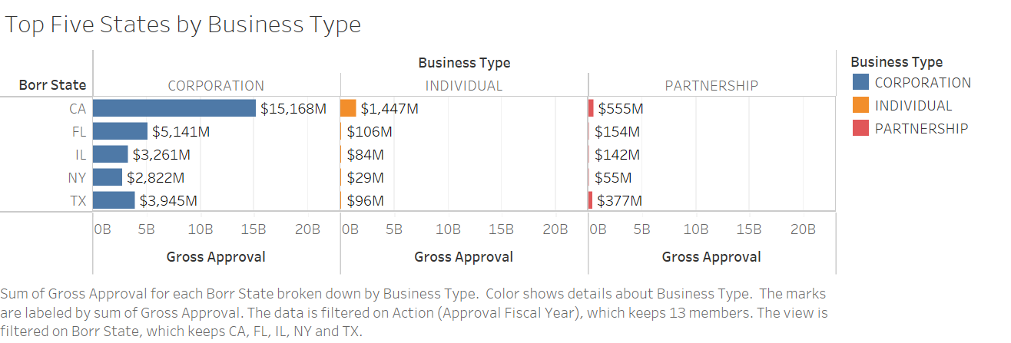
Corporations in California has the highest loan approval amount which is $15 billion followed by Florida $5 billion.
For individual and partnership California is leading on gross approved loan amount. For Individual business type California is getting around $1.5 billion and for partnership California is getting around half billion.

Slide 5
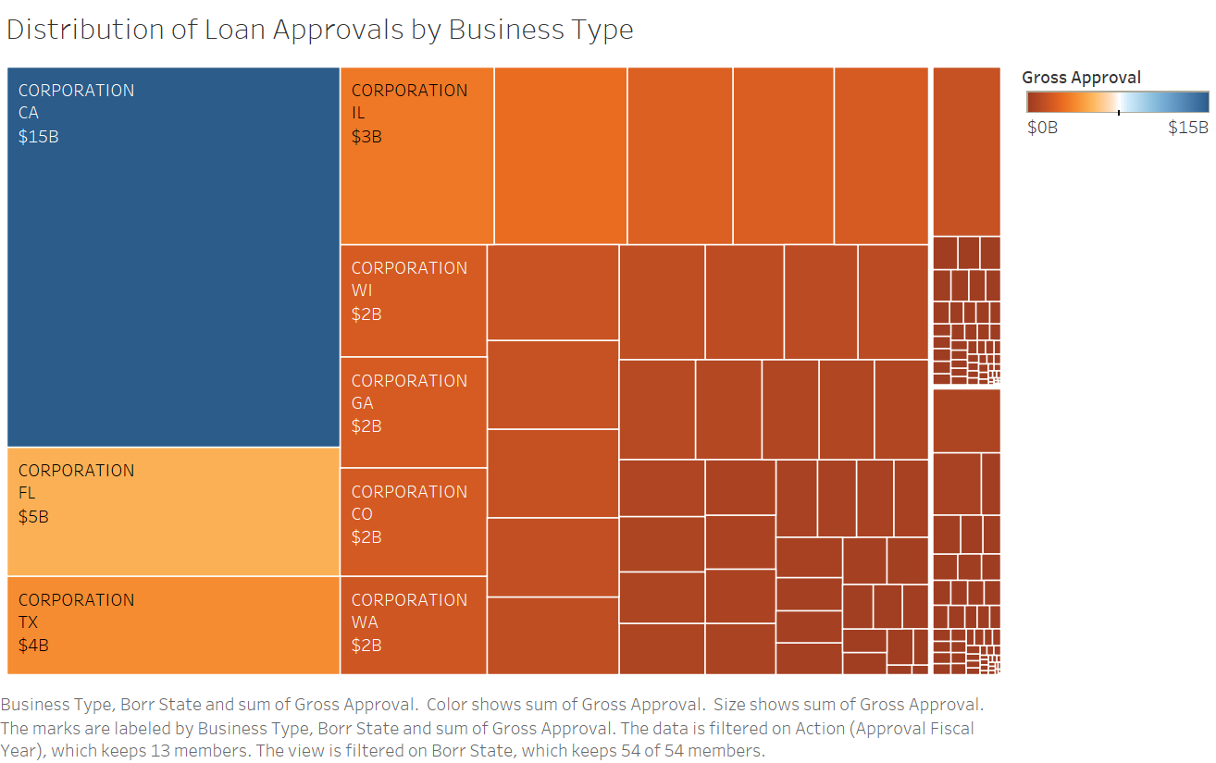
Corporations in California got loan amount approved of $15 billion followed by Florida $5 billion and Texas $4 billion.

Slide 6
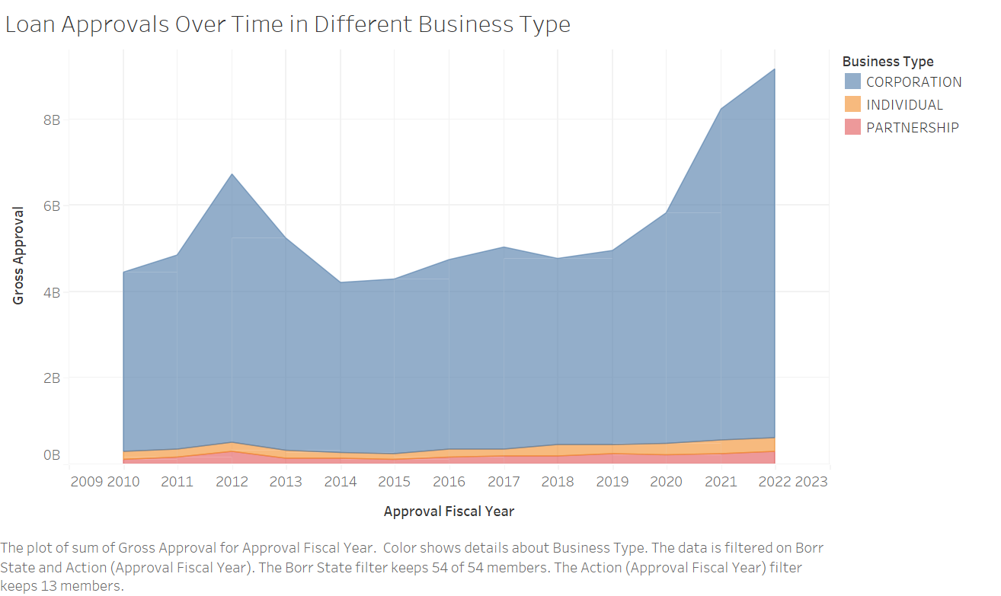
Corporations loan approvals is higher than Individual and partnerships from 2010 to 2022.
There is a huge increase of loan approved amount for corporation in 2012 and then it got declined.

Slide 7
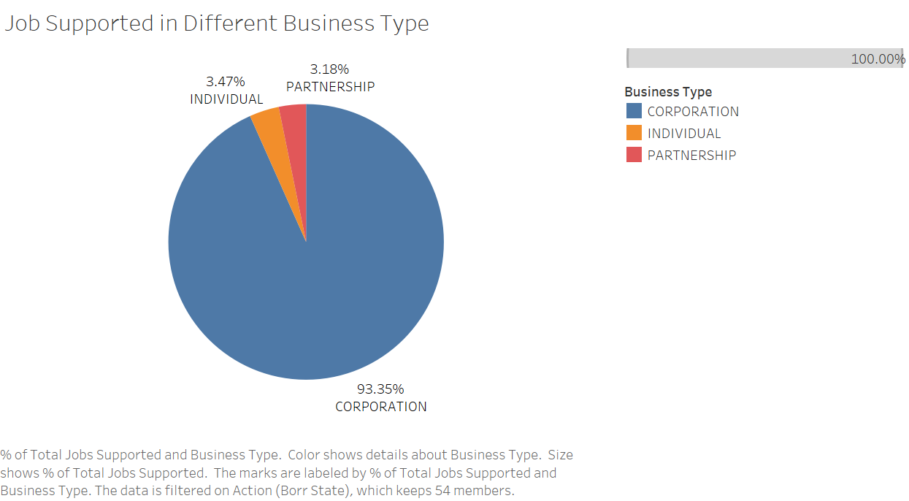
Corporations has supported almost 93.35% of the jobs
Only 3.47% and 3.18% of jobs are supported by Individual and Partnerships.

Slide 8


Corporation Leads

Slide 9
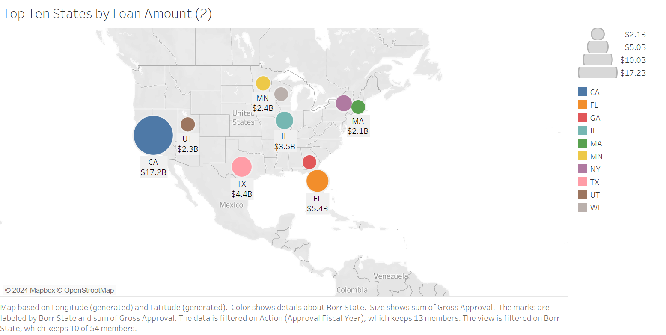
California stands out with the largest bubble, indicating the highest loan amount of $17.2 billion among the top ten states. This suggests that California has a significant demand for loans, possibly due to its large population and diverse economy.
Texas and Florida also show considerable loan amounts of $4.4 billion and $5.4 billion, respectively. This highlights the economic activity and borrowing trends in these populous states, reflecting the importance of loans in supporting various sectors such as real estate, small businesses, and consumer spending.

Slide 10
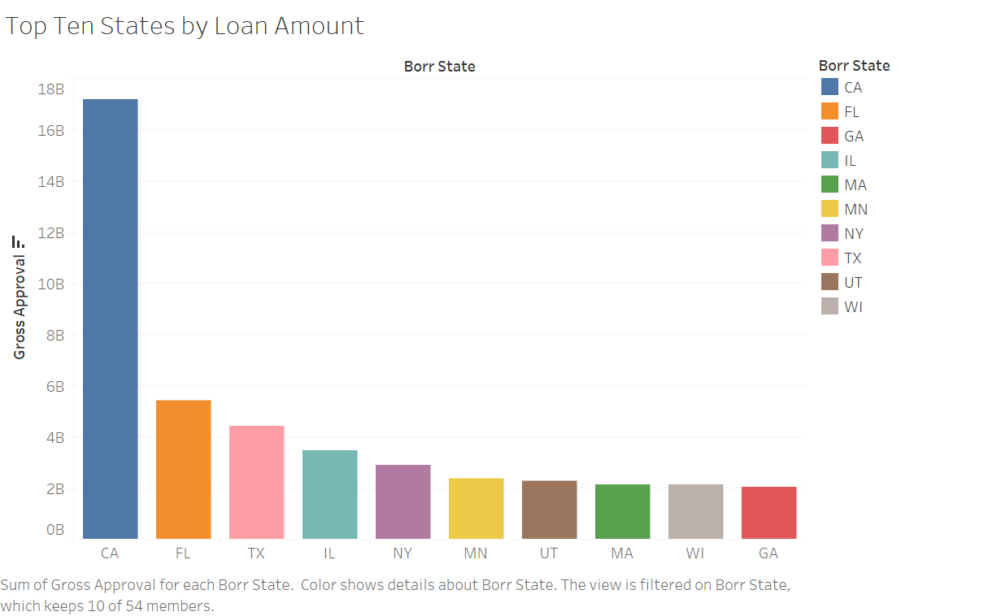
California has the highest loan approval amount followed by Florida and Texas.
The last four states in the top ten which is UT, MA, WI, and GA have almost same amount of loan approval amount.

Slide 11
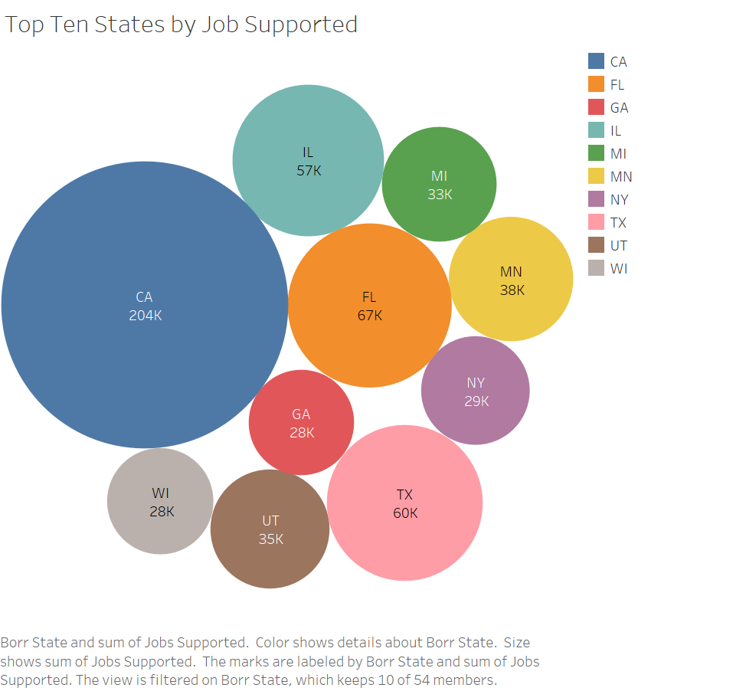
California stands out prominently with the largest bubble, indicating the highest number of jobs supported at 204,000. This suggests that California plays a crucial role in job creation and employment opportunities, reflecting its diverse and dynamic economy across various industries.
Florida and Texas also show significant job support, with 67,000 and 60,000 jobs, respectively. This underscores the importance of these states in providing employment opportunities and contributing to workforce growth, likely driven by their large populations and robust economic sectors such as tourism, technology, and energy.

Slide 12
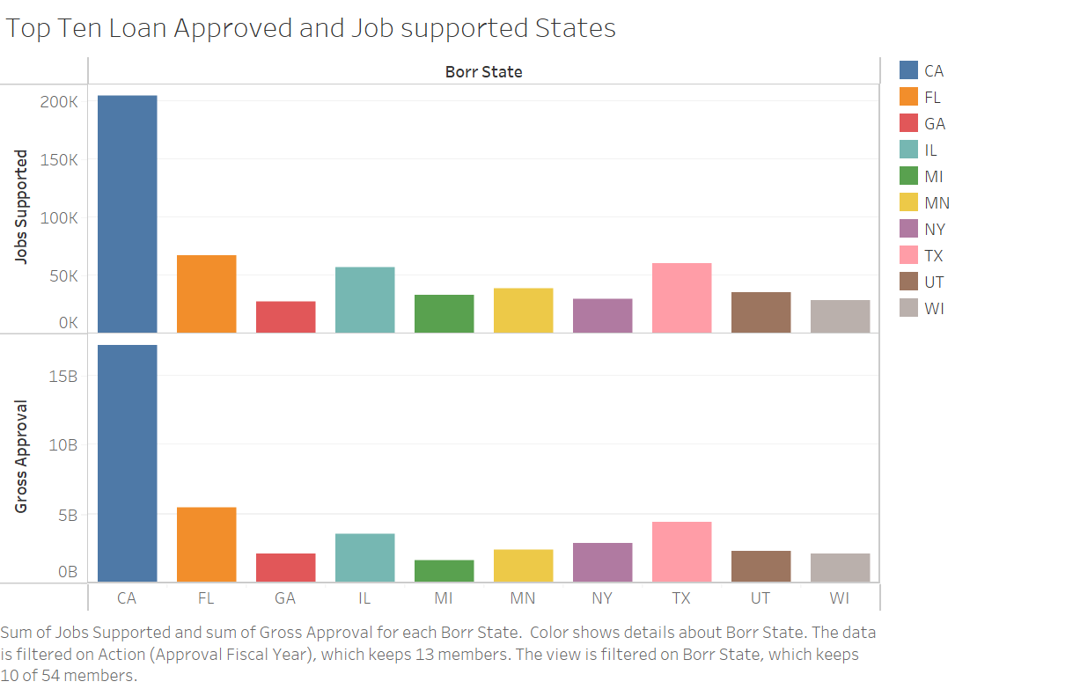
Gross loan amount approval and job supported has a similar trend in all the top ten states.
CA is on top in both cases.
MI has less loan amount still supported good number of jobs.

Slide 13

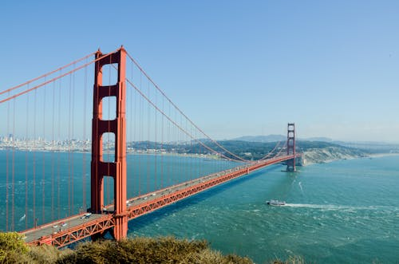
California Leads

Slide 14
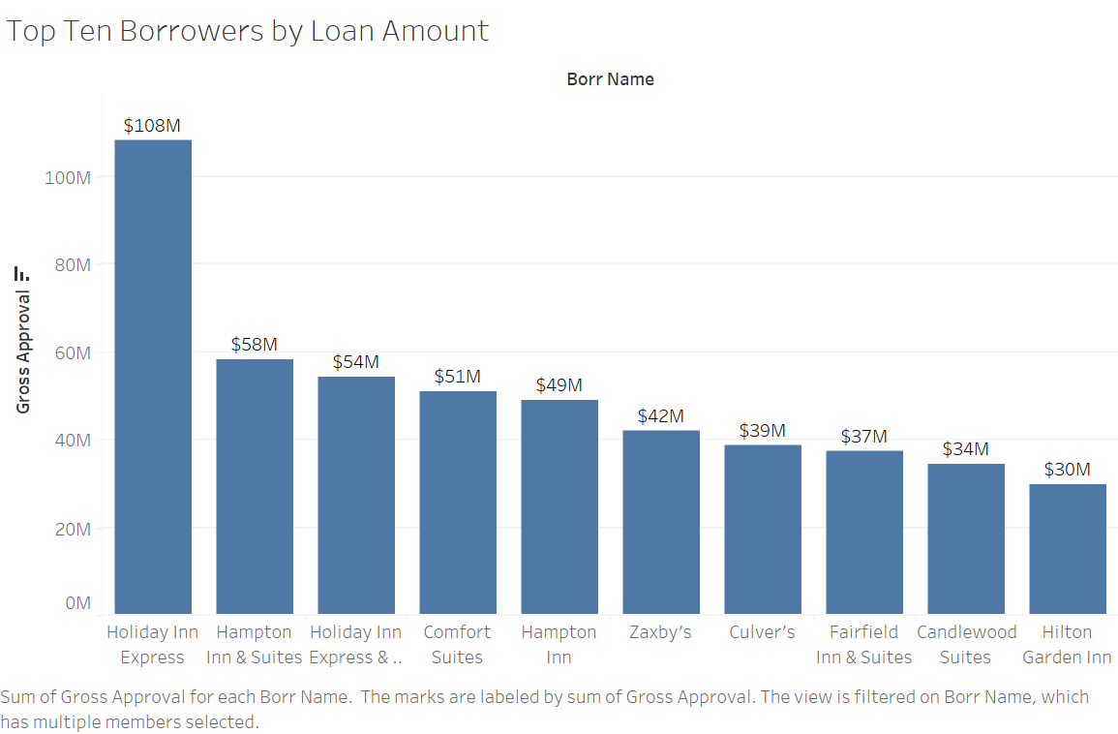
Top borrower is Holiday Inn Express, and they borrowed about $108 million followed by Hampton Inn & Suites who borrowed $58 million.

Slide 15
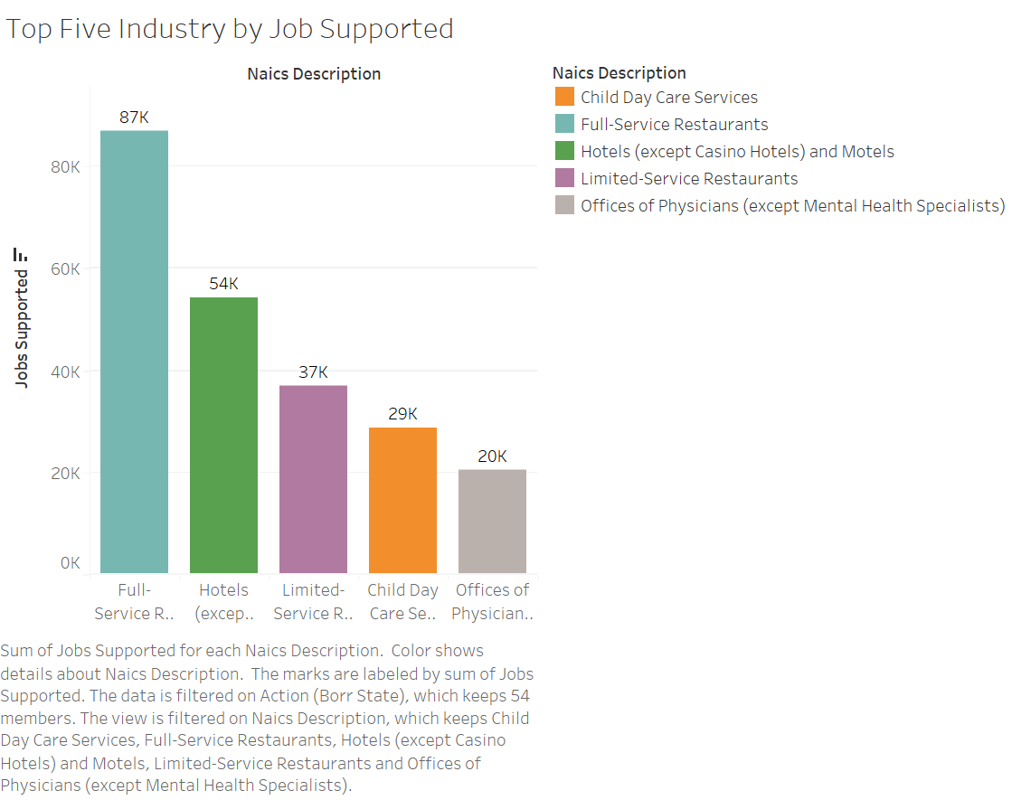
Child Day Care Services and Full-Service Restaurants stand out with the highest number of jobs supported, at 87,000 and 54,000 respectively. This indicates the importance of these industries in providing employment opportunities, especially in areas where these services are in high demand, such as urban centers or areas with a growing population.
Hotels (except Casino Hotels) and Motels, along with Limited-Service Restaurants, show moderate levels of job support, with 37,000 and 29,000 jobs respectively. While not as high as Child Day Care Services and Full-Service Restaurants, these industries still play a significant role in job creation and contribute to employment stability in various communities.

Slide 16
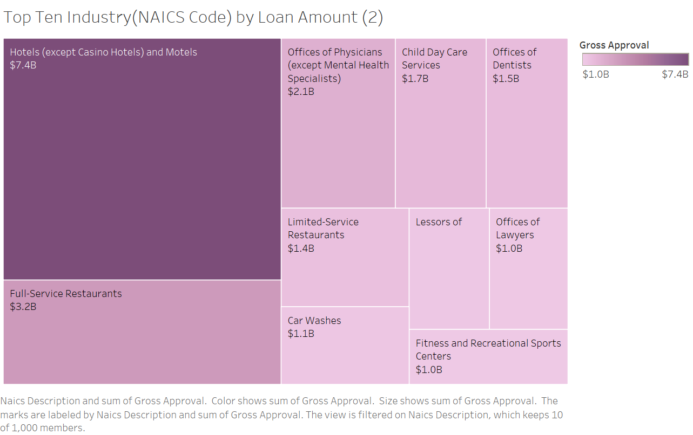
Hotels (except Casino Hotels) and Motels have the highest amount of loan approved which is $7.4 billion followed by full-service Restaurants which is $3.2 billion.

Slide 17


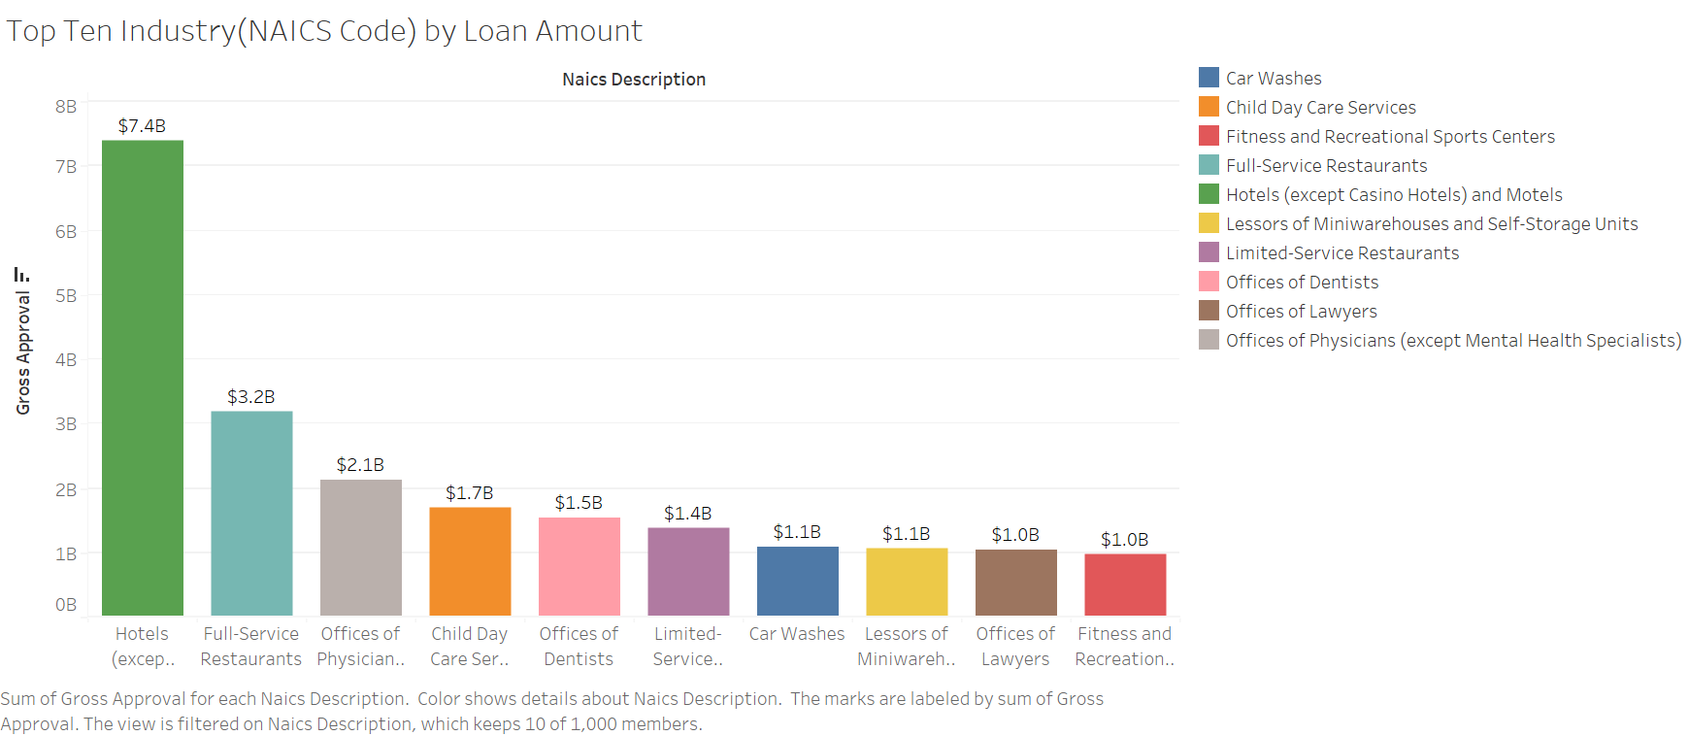
The bar chart depicts the top ten industries by loan amount, based on NAICS code. Hotels (excluding Casino Hotels) and Motels lead with a substantial loan approval of $7.4 billion, followed by Full-Service Restaurants at $3.2 billion.

Slide 18
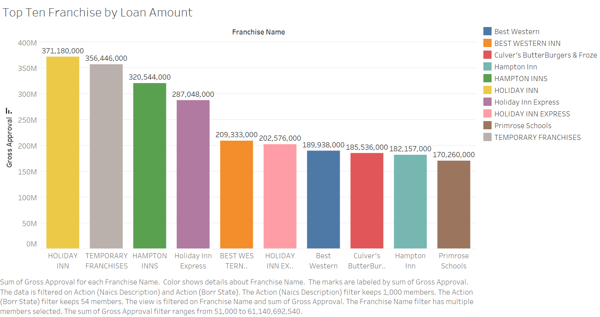
Holiday Inn leads with $371.18 million, followed closely by Temporary Franchises at $356.45 million. Hampton Inns secures the third spot with $320.54 million.

Slide 19


Hotels Leads

Slide 20
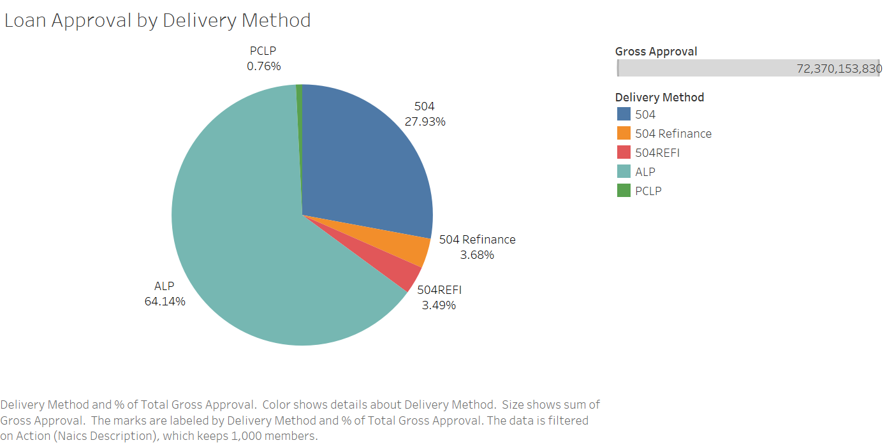
ALP delivery method has the highest loan approvals around 64.14% followed by 504 which is 27.93%

Slide 21
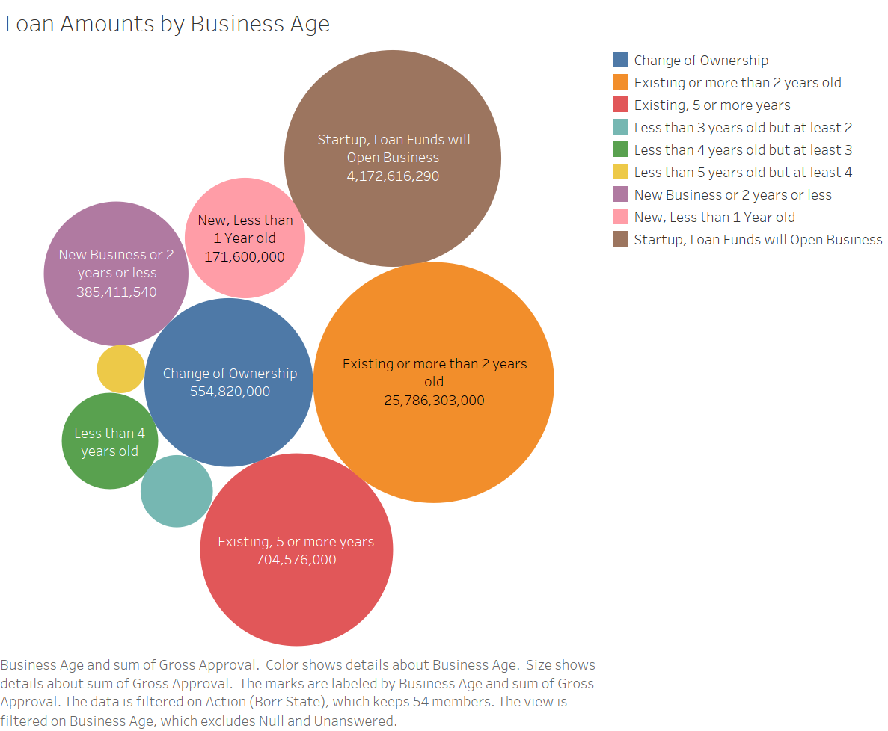
Existing or more than 2 years old companies got the most amount of loan approved around $25 billion.
Startup, Loan Funds will open business got the second highest amount of loan approved around $4 billion.

Slide 22
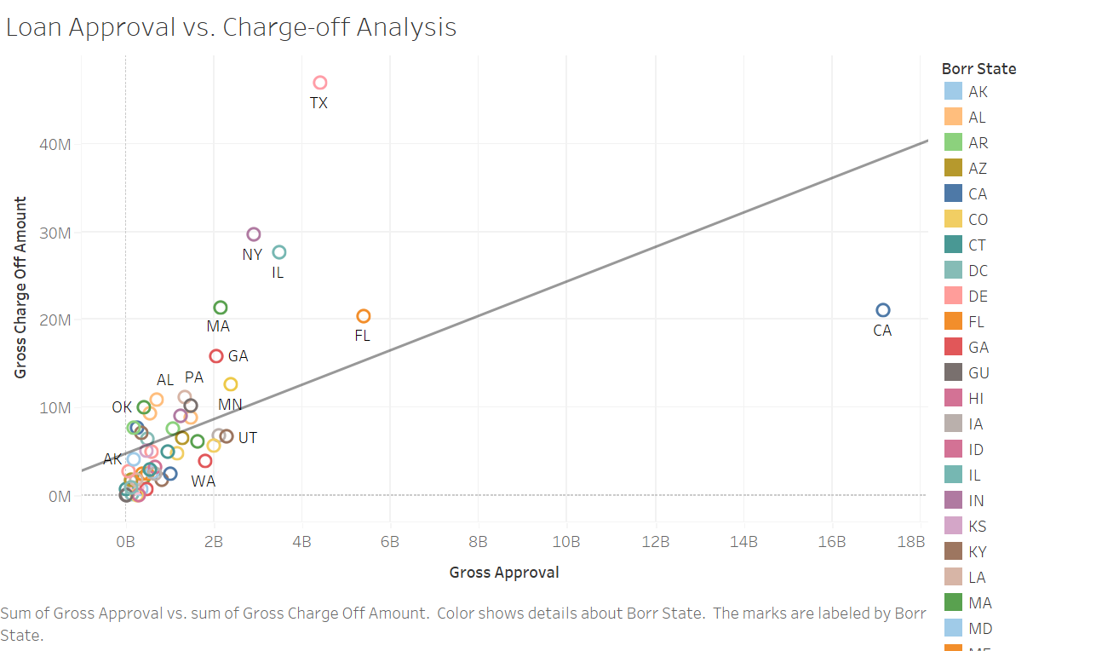
The general trend indicates a positive correlation between loan approval and charge-off amounts. States with higher gross approval amounts also tend to have higher gross charge-off amounts. This suggests that as the volume of approved loans increases, the likelihood of charge-offs also increases, indicating potential risk factors or economic conditions influencing both variables.
Some states, such as CA (California) and FL (Florida), appear as outliers with relatively high gross approval amounts but lower gross charge-off amounts compared to other states with similar approval amounts. This could indicate differences in loan management practices or economic factors specific to these states, warranting further investigation into their loan approval and charge-off processes.

Slide 23
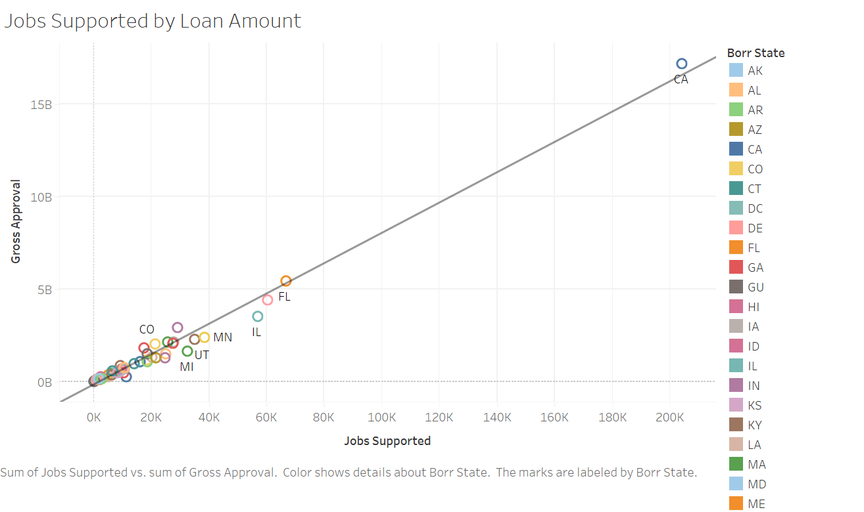
The general trend shows a positive correlation between the number of jobs supported and the gross approval amounts. States with higher gross approval amounts tend to support more jobs, indicating a potential link between loan approval and job creation.
Some states, such as CA (California) and FL (Florida), stand out as outliers with relatively high gross approval amounts compared to the number of jobs supported. This could suggest differences in the efficiency of job creation or economic factors affecting job growth in these states compared to others.

Slide 24
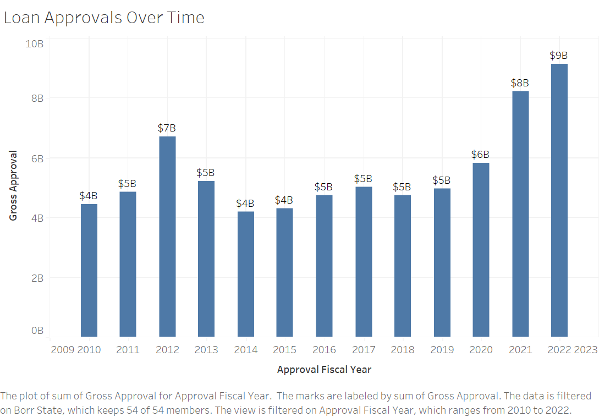
Loan approval amount is fluctuating over the years. In 2012 it got to $7 billion and then declined to $4 billion in 2015.
In 2022, it got to the highest of $9 billion.

Slide 25
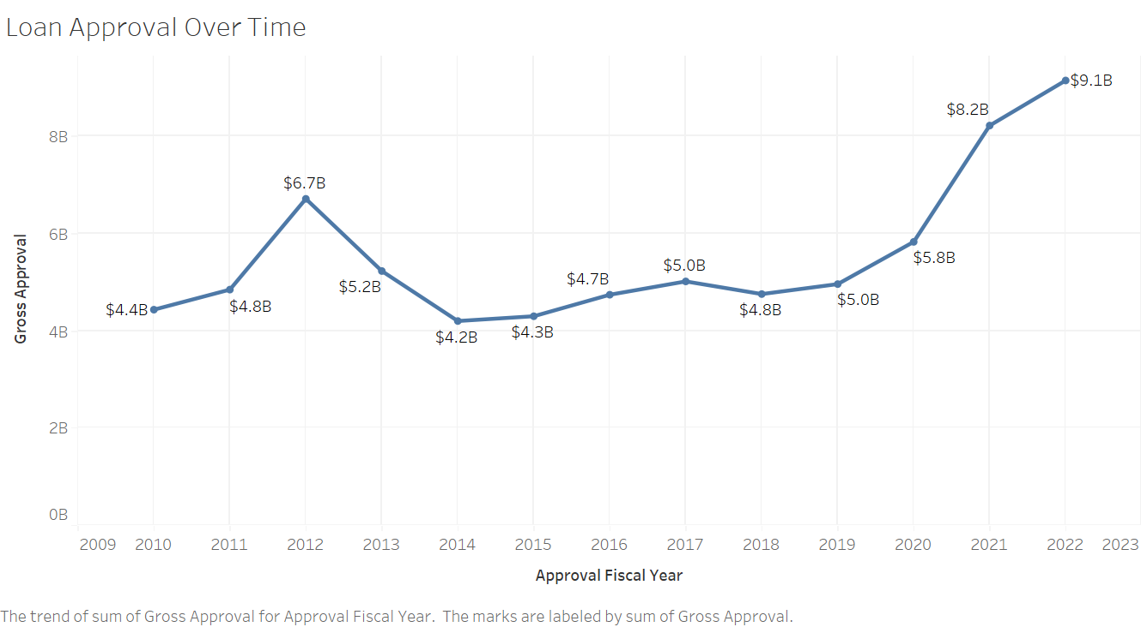
The chart shows a general upward trend in gross approval amounts over the years. Starting from around $4.4 billion in 2010, the gross approval steadily increases, with fluctuations in between, and peaks at approximately $9.1 billion in 2022.
Although there's an overall increasing trend, there are fluctuations in gross approval amounts from year to year. For example, there's a notable increase from 2011 to 2012, followed by a slight decrease in 2014, and then a significant increase in subsequent years.
The factors contributing to this increasing trend could include economic conditions, changes in lending policies, and shifts in demand for loans. The significant increase in gross approval amounts in recent years may indicate increased lending activity or demand for loans during that period.

Slide 26
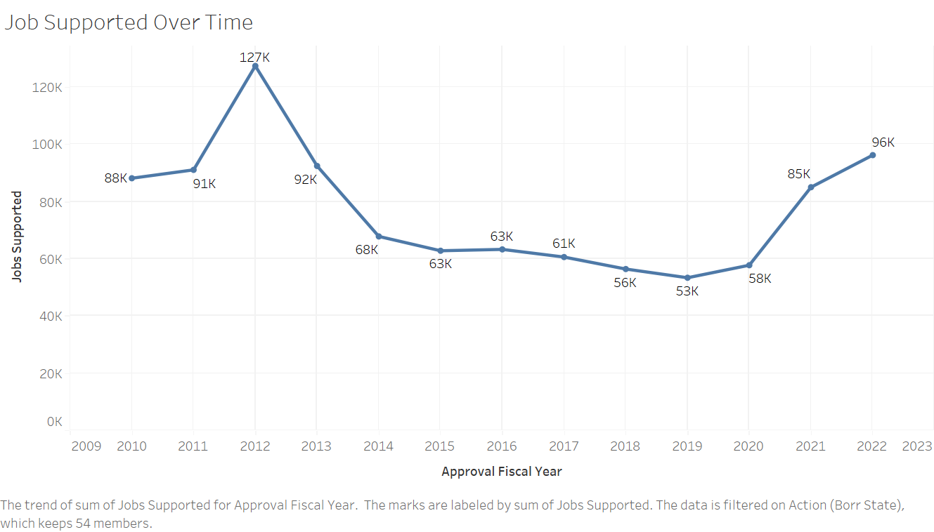
The chart shows fluctuations in the number of jobs supported over the years. There's a peak in the number of jobs supported around 2011-2012, followed by a decline in subsequent years. This is then followed by another peak around 2016-2017, after which there's a notable decrease in the number of jobs supported.
In the later years, particularly from around 2020 onwards, there's a significant increase in the number of jobs supported, with a steep upward trajectory leading to a peak in 2022.
Factors influencing the number of jobs supported could include changes in economic conditions, shifts in industry dynamics, and variations in government policies related to employment and business support.

Slide 27
Dashboards

Slide 28
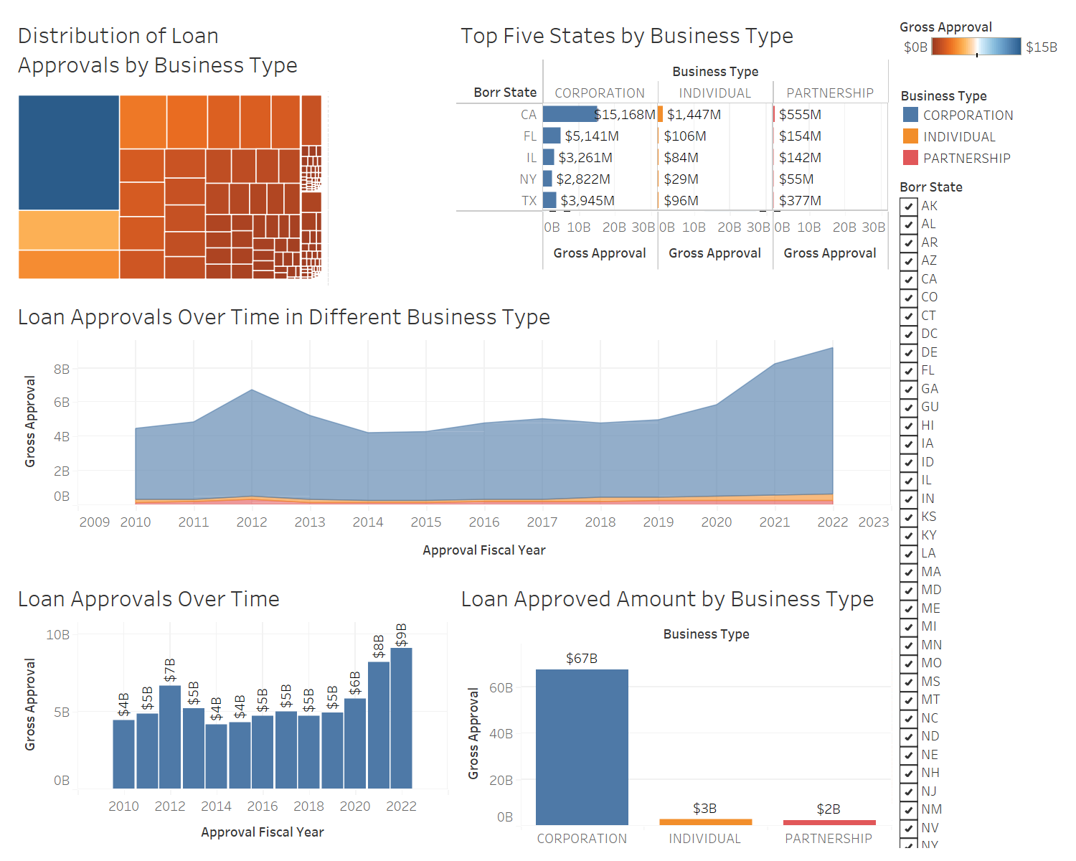
Loan Approval Analysis Dashboard

Slide 29
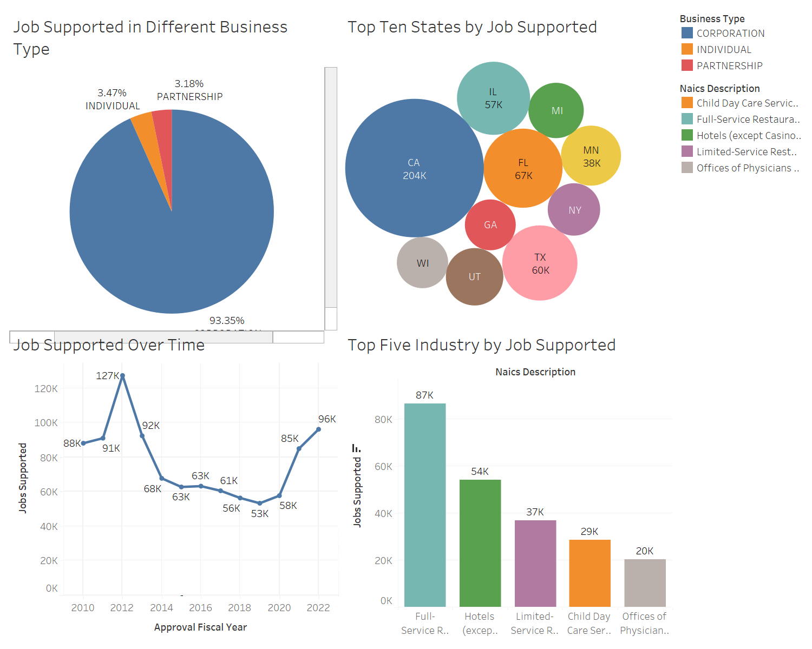
Job Support and Impact
Dashboard

Slide 30
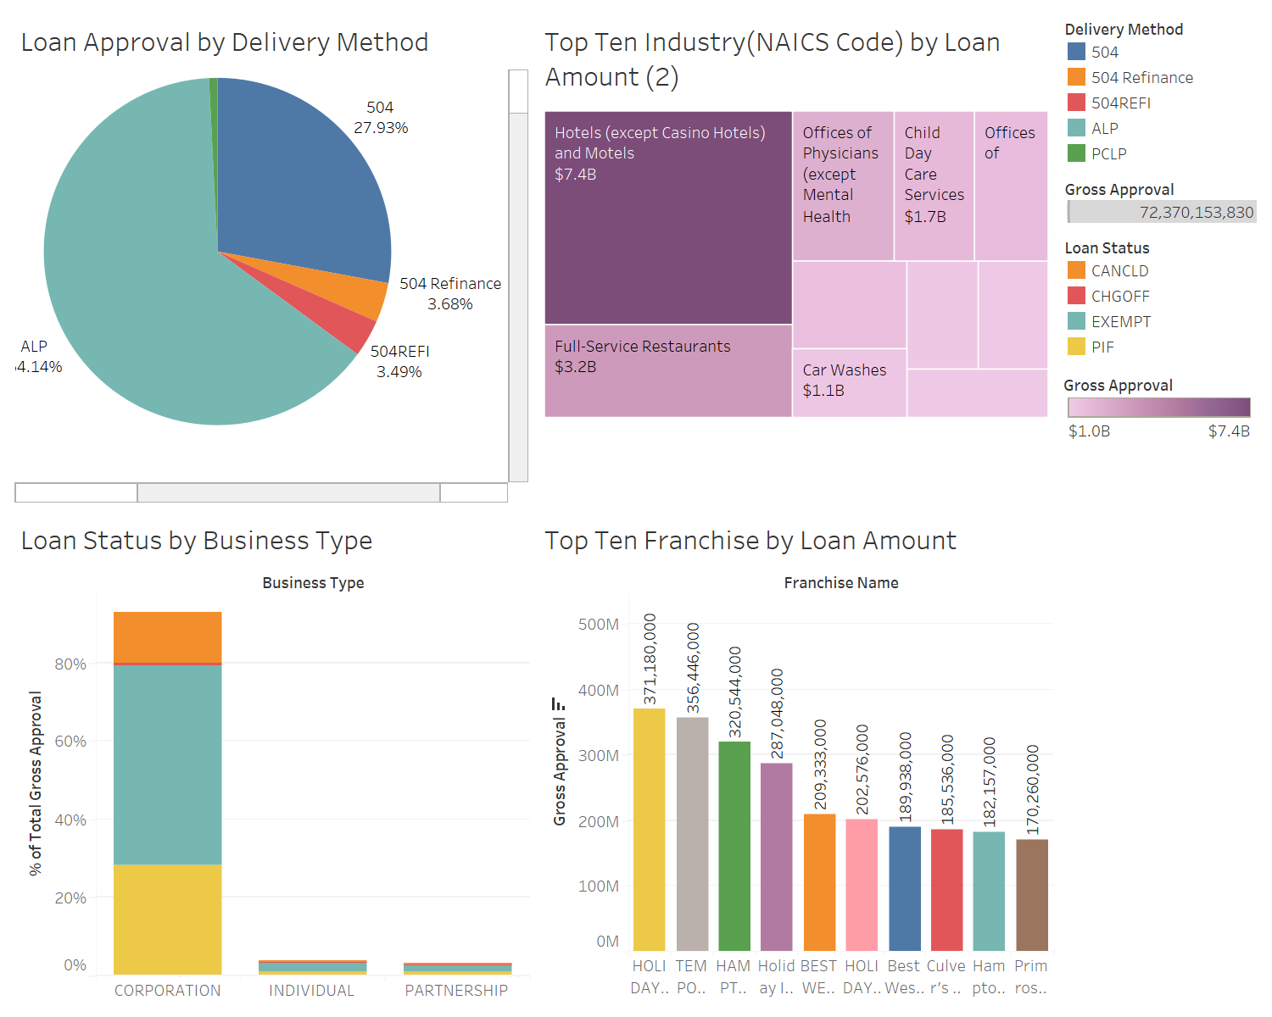
Loan Details and Performance
Dashboard

Slide 31
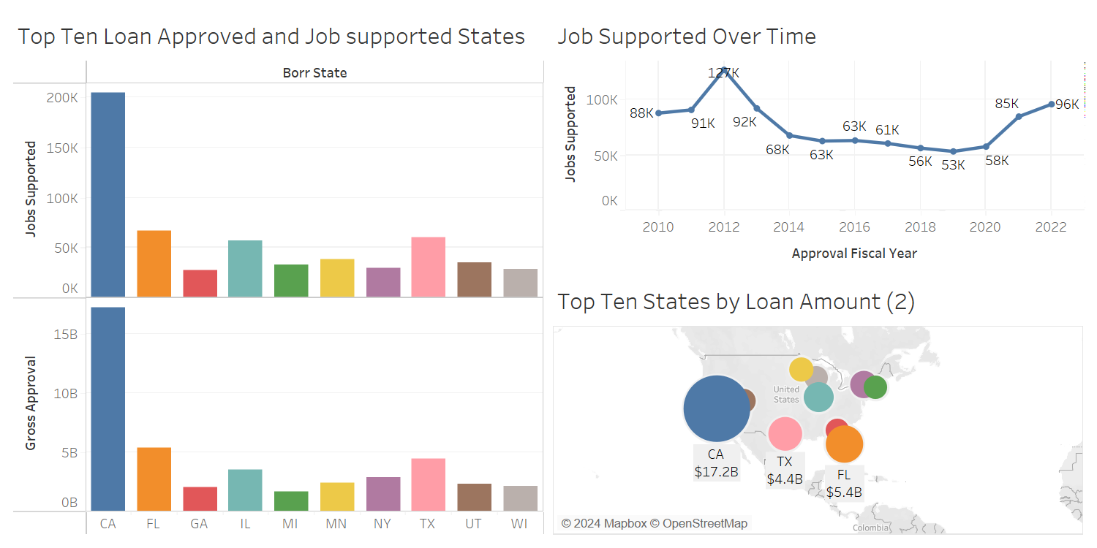
Geographic Insights Dashboard

Slide 32
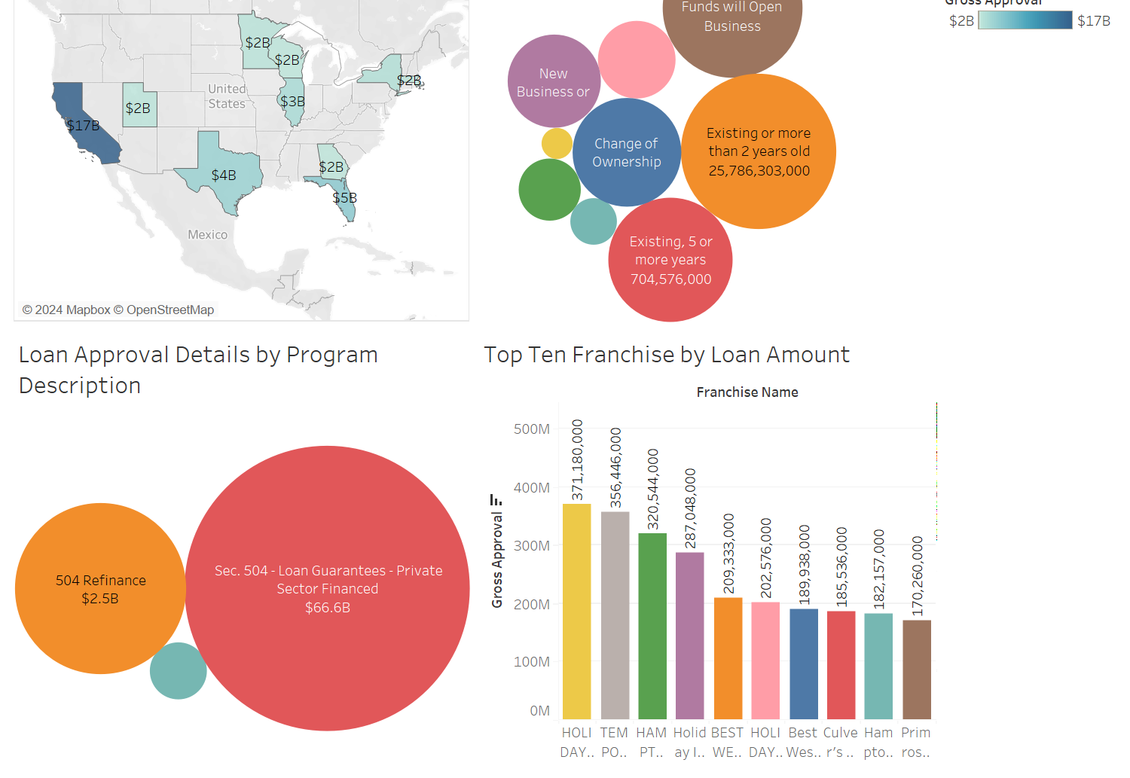
Additional Analysis Dashboard

